Slide 1
Dynamic Programming
Mostafa Hesham 220367

Slide 2
Dynamic Programming Introduction
dynamic programming is both an optimization technique and a computer programming method
The central concept revolves around the ability to dissect complex issues into smaller, recursive subproblems.
then we find the solutions for these subproblems and finally we combine the subresults to find the final solution

Slide 3
Dynamic Programming Introduction
Dynamic programming is an approach used to tackle intricate problems by decomposing them into a set of more manageable and smaller subproblems. The central concept revolves around the ability to dissect complex issues into smaller, recursive subproblems.
dynamic programming takes far less time than other methods that don't take advantage of the subproblem overlap
we need to solve different parts of the problem (subproblems) + combine the solutions of the subproblems to reach an overall solution
we solve each subproblems only once - we reduce the number of computations

Slide 4
So when we can use Dynamic Programming

Slide 5
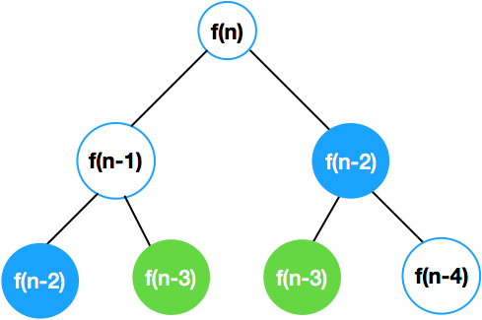
Dynamic Programming
F(N) = F(N-1) + F(N-2)
the formula for calculating the N-th
Fibonacci-number with recursion
(note that there are several overlapping
subproblems we have to solve several times)
dynamic programming
store these values
(so there is no need for recalculating them)

Slide 6
Dynamic Programming
Dynamic programming approach sacrifices extra memory
in exchange for faster running time

Slide 7
Dynamic Programming and Divide and Conquer
several problems can be solved by combining optimal solutions to non-overlapping subproblems
this strategy is called divide and conquer method
overlapping subproblems - dynamic programming
non-overlapping subproblems - divide and conquer method

Slide 8
The Knapsack Problem finds application
Optimizing Material Usage: It helps in finding the most efficient way to cut raw materials to minimize waste.
finding the least wasteful way to cut raw materials
selection of investments and portfolios
selection of assets for asset-backed securitization
construction and scoring of tests in which the test-takers have a choice as to which questions they answer

Slide 9
Knapsack Problem
DIVISIBLE KNAPSACK PROBLEM(we can take fractions of the given items – fast algorithm)
0-1 KNAPSACK PROBLEM (either we take a given item or do not take – complex solution)

Slide 10
Divisible Knapsack Problem
if we can take fractions of the given items then the greedy approach can be used
sort the items according to their values - can be done in O(NlogN)
start with the item that is the most valuable and take as much as possible – starting with highest vi item
than try with the next item from our sorted list – we make a linear search in O(N) time complexity
overall running time is O(NlogN) + O(N) = O(NlogN)
so we can solve the divisible knapsack problem quite fast

Slide 11
0-1 Knapsack Problem
We cannot accept fractions in this situation; instead, we must choose whether to take an item (x=1) or not (x=0).
The best outcome won't be produced by the greedy algorithm.
Another strategy, which is also not a smart one, would be to sort by cost per unit weight and add items from highest to lowest until the knapsack is filled.
With N elements, how many potential solutions are there? The running time of the brute-force method is O(2N) exponential; dynamic programming should be used instead.

Slide 12
0-1 Knapsack Problem
solves larger problem by relating it to overlapping subproblems and then solves the subproblems
it works through the exponential set of solutions, but does not examine them all explicitly

Slide 13
The Knapsack Introduction

Slide 14
Knapsack Problem
This is a problem related to combinatorial optimization
given a set of n items – usually numbered from 1 to n
Each of these items possesses a mass denoted as wi and a corresponding value represented as vi.
Calculate how many of each item should be added to a collection in order to ensure that the cumulative weight, denoted as M, remains below or equal to a specified limit, while maximizing the overall value.
Notes:
Combinatorial optimization is a field of mathematics and computer science that focuses on finding the best solution from a finite set of possibilities in situations where there are multiple options to choose from and an objective function to optimize

Slide 15

Knapsack Problem
Imagine you are preparing for a trip, and you have a maximum luggage weight limit of 15 kilograms imposed by the airline. This luggage weight limit represents your "knapsack capacity."

Slide 16



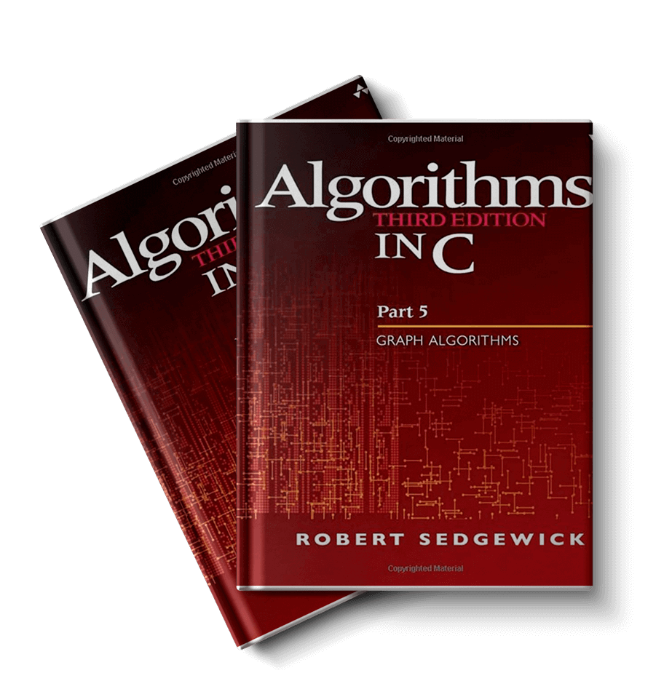

Knapsack Problem
Now, think of the items you want to take with you on your journey as a set of objects. Each of these items has its own weight (in kilograms) and importance to you, perhaps represented by their value.
V$120
3KG
V$50
2KG
V$100
12KG
V$60
10KG

Slide 17


0-1 Knapsack Problem
W1 =5KG
X1 V1=$10
W2=7KG
X2 V2=$13
W3=9KG
X3 V3=$19
W4=2KG
X4 V4=$4
Here we can put items max 10KG
KNAPSACK
M=10 KG

Slide 18
0-1 Knapsack Problem
W1 =5KG
X1 V1=$10
W2=7KG
X2 V2=$13
W3=9KG
W4=2KG
X3 V3=$19
X4 V4=$4
KNAPSACK
M=10 KG

Slide 19
0-1 Knapsack Problem
X1 V1=$10
W2=7KG
X2 V2=$13
W4=2KG
W3=9KG
W1 =5KG
X3 V3=$19
X4 V4=$4
KNAPSACK
M=10 KG

Slide 20
0-1 Knapsack Problem
W1 =5KG
X1 V1=$10
X2 V2=$13
W4=2KG
W3=9KG
W2=7KG
X3 V3=$19
X4 V4=$4
KNAPSACK
M=10 KG

Slide 21
0-1 Knapsack Problem
W1 =5KG
X1 V1=$10
W2=7KG
X2 V2=$13
W3=9KG
X3 V3=$19
W4=2KG
X4 V4=$4
KNAPSACK
M=10 KG

Slide 22
0-1 Knapsack Problem
W1 =5KG
X1 V1=$10
W2=7KG
X2 V2=$13
W3=9KG
X3 V3=$19
W4=2KG
X4 V4=$4
KNAPSACK
M=10 KG

Slide 23
0-1 Knapsack Problem
Subproblems must be defined. For example, given N items, we must decide N times whether to accept an item with a certain index or not. the answer taking into account all potential pairings of residual items and residual weight
The subproblem relating to the first i items and available weight is solved by S[i][w]. w
The greatest price of goods that can fit in a backpack of a given size and weight is S[i][w]. Therefore, selecting an item from the first I options, we must choose whether to accept it or not.

Slide 24
0-1 Knapsack Problem
If we consider all subsets of the items – there may be 2 cases:
the given item is included in the solution (optimal subset)
the given item is not included
So the maximum value (solution) can be reduced to smaller andsmaller subproblems – and these subproblems overlap
The i-th item is not included which means that the max value is obtained by the previous N-1 items (and M total weights)
The i-th item is included – max value is vi plus the values obtained by the previous N-1 items (and M-wi total weights)

Slide 25
0-1 Knapsack Problem
running time of Knapsack: O(nW)
but it is not polynomial
Notes:
the running time of O(nW) for the 0-1 Knapsack Problem is not polynomial-time because the knapsack capacity “W" is not bounded by a polynomial in the input size. It's important to distinguish between polynomial-time algorithms, where the running time is bounded by a polynomial in the input size, and algorithms with polynomial-like expressions where the "polynomial" term depends on parameters unrelated to the input size.

Slide 26
Knapsack Problem Example

Slide 27
0-1 Knapsack Problem
N= 3Items W = 5kg capacity of knapsack
item 1 w1 = 4kg v1 = $10
item 2 w2 = 2kg v2 = $4
item 3 w3 = 3kg v3 = $7
 | 0 | 1 | 2 | 3 | 4 | 5
0
1
2
3
weights [kg]
No Items
[Item 1]
[Item 1,Item 2]
all Items

Slide 28
0-1 Knapsack Problem
N= 3Items M = 5kg capacity of knapsack
item 1 w1 = 4kg v1 = $10
item 2 w2 = 2kg v2 = $4
item 3 w3 = 3kg v3 = $7
We will fill it with 0 because there is no
 | 0 | 1 | 2 | 3 | 4 | 5
0 | 0 | 0 | 0 | 0 | 0 | 0
1
2
3
weights [kg]
No Items
[Item 1]
[Item 1,Item 2]
all Items

Slide 29
0-1 Knapsack Problem
N= 3Items M = 5kg capacity of knapsack
item 1 w1 = 4kg v1 = $10
item 2 w2 = 2kg v2 = $4
item 3 w3 = 3kg v3 = $7
Here we fill the it because the is 0
 | 0 | 1 | 2 | 3 | 4 | 5
0 | 0 | 0 | 0 | 0 | 0 | 0
1 | 0
2 | 0
3 | 0
weights [kg]
No Items
[Item 1]
[Item 1,Item 2]
all Items

Slide 30
0-1 Knapsack Problem
N= 3Items M = 5kg capacity of knapsack
item 1 w1 = 4kg v1 = $10
item 2 w2 = 2kg v2 = $4
item 3 w3 = 3kg v3 = $7
Here we fill the it because the is 0
 | 0 | 1 | 2 | 3 | 4 | 5
0 | 0 | 0 | 0 | 0 | 0 | 0
1 | 0 | 0 | 0 | 0
2 | 0
3 | 0
weights [kg]
No Items
[Item 1]
[Item 1,Item 2]
all Items

Slide 31
0-1 Knapsack Problem
N= 3Items M = 5kg capacity of knapsack
item 1 w1 = 4kg v1 = $10
item 2 w2 = 2kg v2 = $4
item 3 w3 = 3kg v3 = $7
We will put the v of item 1 in row colm 4when it get to 4KG V1=10 same as when the W gets to 5
 | 0 | 1 | 2 | 3 | 4 | 5
0 | 0 | 0 | 0 | 0 | 0 | 0
1 | 0 | 0 | 0 | 0 | 10 | 10
2 | 0
3 | 0
weights [kg]
No Items
[Item 1]
[Item 1,Item 2]
all Items

Slide 32
0-1 Knapsack Problem
N= 3Items M = 5kg capacity of knapsack
item 1 w1 = 4kg v1 = $10
item 2 w2 = 2kg v2 = $4
item 3 w3 = 3kg v3 = $7
Here we will put the v2 value in r2 c2
 | 0 | 1 | 2 | 3 | 4 | 5
0 | 0 | 0 | 0 | 0 | 0 | 0
1 | 0 | 0 | 0 | 0 | 10 | 10
2 | 0 | 0 | 4 | 4
3 | 0
weights [kg]
No Items
[Item 1]
[Item 1,Item 2]
all Items
X[i][w] =max(X[i-1][w] ; vali + X[i-1][w-wi]) = max(0,4)

Slide 33
0-1 Knapsack Problem
N= 3Items M = 5kg capacity of knapsack
item 1 w1 = 4kg v1 = $10
item 2 w2 = 2kg v2 = $4
item 3 w3 = 3kg v3 = $7
we will put the V1 value in r2 c4 and c5 because it is [Item 1,Item 2] so we will take the max it will be V1
 | 0 | 1 | 2 | 3 | 4 | 5
0 | 0 | 0 | 0 | 0 | 0 | 0
1 | 0 | 0 | 0 | 0 | 10 | 10
2 | 0 | 0 | 4 | 4 | 10 | 10
3 | 0
weights [kg]
No Items
[Item 1]
[Item 1,Item 2]
all Items
X[i][w] =max(X[i-1][w] ; vali + X[i-1][w-wi]) = max(10,4)

Slide 34
0-1 Knapsack Problem
N= 3Items M = 5kg capacity of knapsack
item 1 w1 = 4kg v1 = $10
item 2 w2 = 2kg v2 = $4
item 3 w3 = 3kg v3 = $7
 | 0 | 1 | 2 | 3 | 4 | 5
0 | 0 | 0 | 0 | 0 | 0 | 0
1 | 0 | 0 | 0 | 0 | 10 | 10
2 | 0 | 0 | 4 | 4 | 10 | 10
3 | 0 | 0 | 4
weights [kg]
No Items
[Item 1]
[Item 1,Item 2]
all Items
X[i][w] =max(X[i-1][w] ; vali + X[i-1][w-wi]) = max(4,0)

Slide 35
0-1 Knapsack Problem
N= 3Items M = 5kg capacity of knapsack
item 1 w1 = 4kg v1 = $10
item 2 w2 = 2kg v2 = $4
item 3 w3 = 3kg v3 = $7
Here we have the v2 and v3 we will take the max which is v3=7
 | 0 | 1 | 2 | 3 | 4 | 5
0 | 0 | 0 | 0 | 0 | 0 | 0
1 | 0 | 0 | 0 | 0 | 10 | 10
2 | 0 | 0 | 4 | 4 | 10 | 10
3 | 0 | 0 | 4 | 7
weights [kg]
No Items
[Item 1]
[Item 1,Item 2]
all Items
X[i][w] =max(X[i-1][w] ; vali + X[i-1][w-wi]) = max(4,7)

Slide 36
0-1 Knapsack Problem
N= 3Items M = 5kg capacity of knapsack
item 1 w1 = 4kg v1 = $10
item 2 w2 = 2kg v2 = $4
item 3 w3 = 3kg v3 = $7
Max will be V1=10
 | 0 | 1 | 2 | 3 | 4 | 5
0 | 0 | 0 | 0 | 0 | 0 | 0
1 | 0 | 0 | 0 | 0 | 10 | 10
2 | 0 | 0 | 4 | 4 | 10 | 10
3 | 0 | 0 | 4 | 7 | 10
weights [kg]
No Items
[Item 1]
[Item 1,Item 2]
all Items
X[i][w] =max(X[i-1][w] ; vali + X[i-1][w-wi]) = max(10,7)

Slide 37
0-1 Knapsack Problem
Here the max KG is 5KG and we want to take the max between V1,V2,V3
W1 is=4KG,W2 =2kg and W3=3kg the max here is the value of V!=10
But we can add V2 + V3 =11 and they will be =5kg because W2+W3=5kg
N= 3Items M = 5kg capacity of knapsack
item 1 w1 = 4kg v1 = $10
item 2 w2 = 2kg v2 = $4
item 3 w3 = 3kg v3 = $7
 | 0 | 1 | 2 | 3 | 4 | 5
0 | 0 | 0 | 0 | 0 | 0 | 0
1 | 0 | 0 | 0 | 0 | 10 | 10
2 | 0 | 0 | 4 | 4 | 10 | 10
3 | 0 | 0 | 4 | 7 | 10
weights [kg]
No Items
[Item 1]
[Item 1,Item 2]
all Items

Slide 38
0-1 Knapsack Problem
Here the max KG is 5KG and we want to take the max between V1,V2,V3
W1 is=4KG,W2 =2kg and W3=3kg the max here is the value of V!=10
But we can add V2 + V3 =11 and they will be =5kg because W2+W3=5kg
N= 3Items M = 5kg capacity of knapsack
item 1 w1 = 4kg v1 = $10
item 2 w2 = 2kg v2 = $4
item 3 w3 = 3kg v3 = $7
 | 0 | 1 | 2 | 3 | 4 | 5
0 | 0 | 0 | 0 | 0 | 0 | 0
1 | 0 | 0 | 0 | 0 | 10 | 10
2 | 0 | 0 | 4 | 4 | 10 | 10
3 | 0 | 0 | 4 | 7 | 10 | 11
weights [kg]
No Items
[Item 1]
[Item 1,Item 2]
all Items

Slide 39
0-1 Knapsack Problem
N= 3Items M = 5kg capacity of knapsack
item 1 w1 = 4kg v1 = $10
item 2 w2 = 2kg v2 = $4
item 3 w3 = 3kg v3 = $7
 | 0 | 1 | 2 | 3 | 4 | 5
0 | 0 | 0 | 0 | 0 | 0 | 0
1 | 0 | 0 | 0 | 0 | 10 | 10
2 | 0 | 0 | 4 | 4 | 10 | 10
3 | 0 | 0 | 4 | 7 | 10 | 11
weights [kg]
No Items
[Item 1]
[Item 1,Item 2]
all Items
we know that the maximum profit is $11 but how
wo achieve this result – what items to include?

Slide 40
0-1 Knapsack Problem what items to include?
we start with the last item (last row and last column) and we keep comparing the items right above (below) each other
if the 2 values are the same: it means we have not included the given item in the knapsack (so we take 1 step upwards in the X table)
otherwise we take 1 step upwards and take as many steps to the left as the w weight of that item

Slide 41
0-1 Knapsack Problem
N= 3Items M = 5kg capacity of knapsack
item 1 w1 = 4kg v1 = $10
item 2 w2 = 2kg v2 = $4
item 3 w3 = 3kg v3 = $7
 | 0 | 1 | 2 | 3 | 4 | 5
0 | 0 | 0 | 0 | 0 | 0 | 0
1 | 0 | 0 | 0 | 0 | 10 | 10
2 | 0 | 0 | 4 | 4 | 10 | 10
3 | 0 | 0 | 4 | 7 | 10 | 11
weights [kg]
No Items
[Item 1]
[Item 1,Item 2]
all Items

Slide 42
0-1 Knapsack Problem
N= 3Items M = 5kg capacity of knapsack
item 1 w1 = 4kg v1 = $10
item 2 w2 = 2kg v2 = $4
item 3 w3 = 3kg v3 = $7
 | 0 | 1 | 2 | 3 | 4 | 5
0 | 0 | 0 | 0 | 0 | 0 | 0
1 | 0 | 0 | 0 | 0 | 10 | 10
2 | 0 | 0 | 4 | 4 | 10 | 10
3 | 0 | 0 | 4 | 7 | 10 | 11
weights [kg]
No Items
[Item 1]
[Item 1,Item 2]
all Items

Slide 43
0-1 Knapsack Problem
N= 3Items M = 5kg capacity of knapsack
item 1 w1 = 4kg v1 = $10
item 2 w2 = 2kg v2 = $4
item 3 w3 = 3kg v3 = $7
 | 0 | 1 | 2 | 3 | 4 | 5
0 | 0 | 0 | 0 | 0 | 0 | 0
1 | 0 | 0 | 0 | 0 | 10 | 10
2 | 0 | 0 | 4 | 4 | 10 | 10
3 | 0 | 0 | 4 | 7 | 10 | 11
weights [kg]
No Items
[Item 1]
[Item 1,Item 2]
all Items

Slide 44
0-1 Knapsack Problem
N= 3Items M = 5kg capacity of knapsack
item 1 w1 = 4kg v1 = $10
item 2 w2 = 2kg v2 = $4
item 3 w3 = 3kg v3 = $7
 | 0 | 1 | 2 | 3 | 4 | 5
0 | 0 | 0 | 0 | 0 | 0 | 0
1 | 0 | 0 | 0 | 0 | 10 | 10
2 | 0 | 0 | 4 | 4 | 10 | 10
3 | 0 | 0 | 4 | 7 | 10 | 11
weights [kg]
No Items
[Item 1]
[Item 1,Item 2]
all Items

Slide 45



0-1 Knapsack Problem
# O(n*w)
def knapSack(W, wt, val, n):
K = [[0 for x in range(W + 1)] for x in range(n + 1)]
for i in range(n + 1):
for j in range(W + 1):
if i == 0 or j == 0:
K[i][j] = 0
elif wt[i-1] <= j:
K[i][j] = max(val[i-1] + K[i-1][j-wt[i-1]],K[i-1][j])
else:
K[i][j] = K[i-1][j]
$$\sum_{i=0}^{n}{}\sum_{j=0}^{w}{1}$$
$$\sum_{i=0}^{n}{\left(w−0+1\right)}$$
$${}^{w}\sum_{i=0}^{n}{{1 =w∗(n−0+1)}^{}}$$
O(n*w)

Slide 46
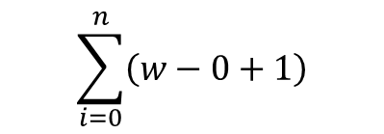

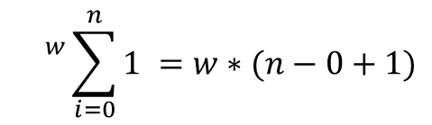
0-1 Knapsack Problem
$$\sum_{i=0}^{n}{}\sum_{j=0}^{w}{1}$$
$$\sum_{i=0}^{n}{\left(w−0+1\right)}$$
$${}^{w}\sum_{i=0}^{n}{{1 =w∗(n−0+1)}^{}}$$
O(n*w)

